Slide 1
ATAI
Advanced Technique of Artificial Intelligence
ATAI
ChongqingUniversity _{AdvancedTechniqueof}
of Technology Artificial Intelligence
Chongqing University of
Technology
Chongqing University ^{ATAI}
_{of Technology} Advanced Techniqueof
Artificial Intelligence
Chongqing University of Technology
Chongqing University of Technology
Modality-Independent Graph Neural Networks with Global Transformers forMultimodal Recommendation
Code : https://github.com/CrawlScript/MIG-GT
—— AAAI2025
Reported by Jing Li
1

Slide 2
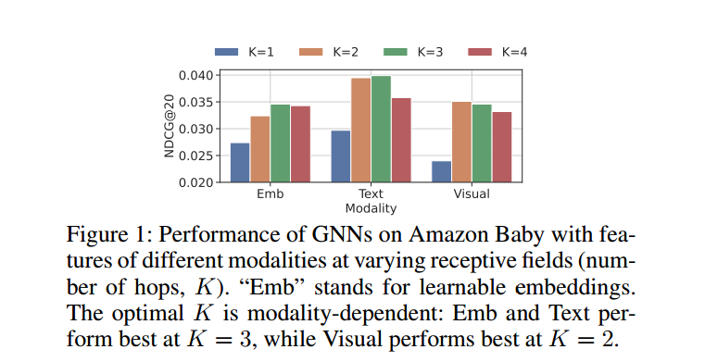
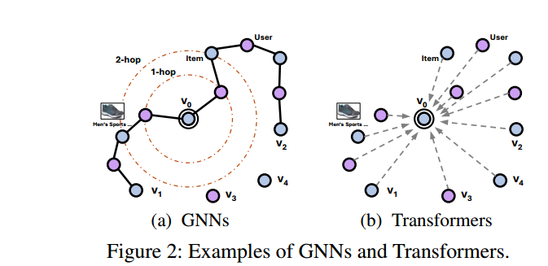
ATAI
Advanced Technique of Artificial Intelligence
ATAI
ChongqingUniversity _{AdvancedTechniqueof}
of Technology Artificial Intelligence
Chongqing University of
Technology
Chongqing University ^{ATAI}
_{of Technology} Advanced Techniqueof
Artificial Intelligence
Chongqing University of Technology
Chongqing University of Technology
Introduction
1、Existing studies default to setting the same K for GNNs across all modalities. However, we observe that the optimal receptive field for GNNs differs across modalities.
2、The optimal K for certain modalities on specific datasets can be as low as 1 or 2, limiting GNNs’ ability to capture global information from vertices across the whole graph. Transformers can potentially capture global information in graphs，However, Transformers typically require computing attention scores for every vertex pair, resulting in excessive time and space complexity.

Slide 3
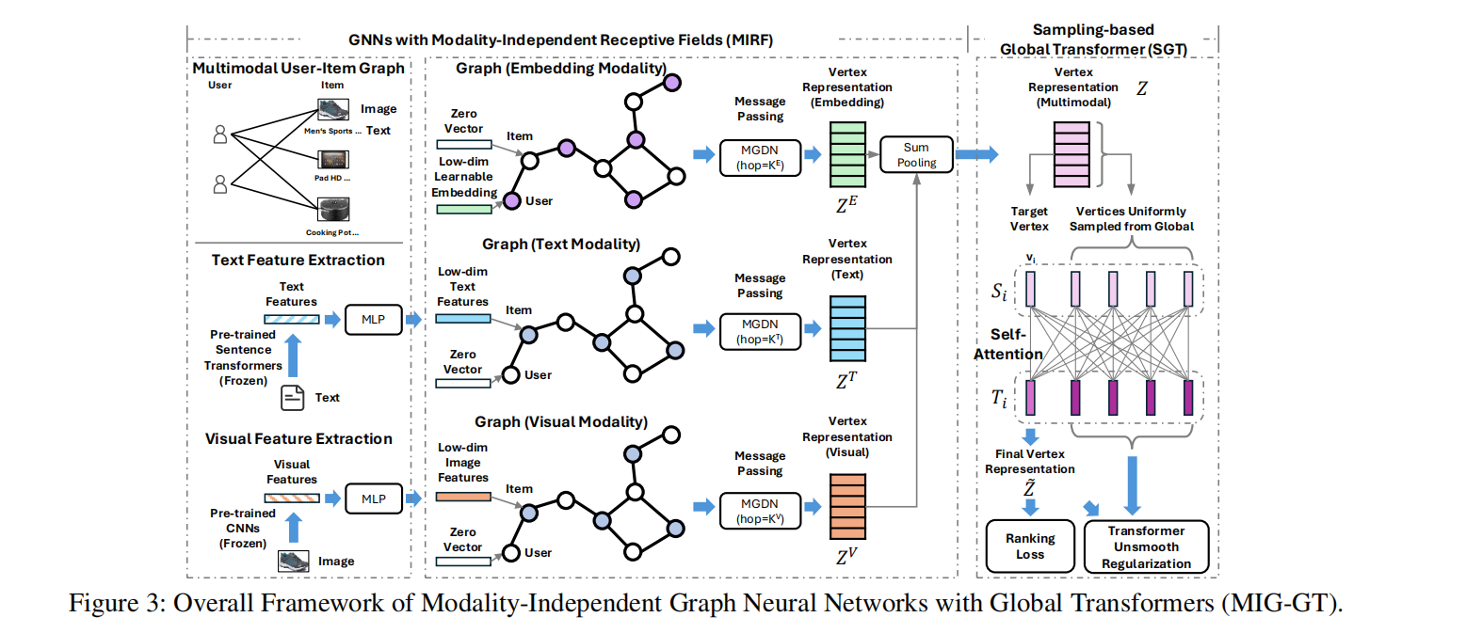
ATAI
Advanced Technique of Artificial Intelligence
ATAI
ChongqingUniversity _{AdvancedTechniqueof}
of Technology Artificial Intelligence
Chongqing University of
Technology
Chongqing University ^{ATAI}
_{of Technology} Advanced Techniqueof
Artificial Intelligence
Chongqing University of Technology
Chongqing University of Technology
Overview

Slide 4
ATAI
Advanced Technique of Artificial Intelligence
ATAI
ChongqingUniversity _{AdvancedTechniqueof}
of Technology Artificial Intelligence
Chongqing University of
Technology
Chongqing University ^{ATAI}
_{of Technology} Advanced Techniqueof
Artificial Intelligence
Chongqing University of Technology
Chongqing University of Technology
Method

Slide 5
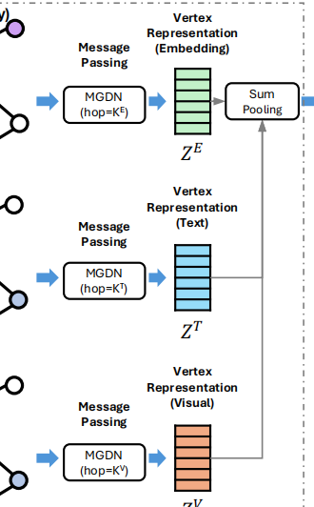
ATAI
Advanced Technique of Artificial Intelligence
ATAI
ChongqingUniversity _{AdvancedTechniqueof}
of Technology Artificial Intelligence
Chongqing University of
Technology
Chongqing University ^{ATAI}
_{of Technology} Advanced Techniqueof
Artificial Intelligence
Chongqing University of Technology
Chongqing University of Technology
Method

Slide 6
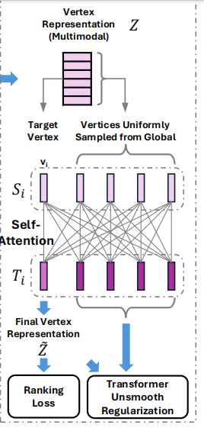
ATAI
Advanced Technique of Artificial Intelligence
ATAI
ChongqingUniversity _{AdvancedTechniqueof}
of Technology Artificial Intelligence
Chongqing University of
Technology
Chongqing University ^{ATAI}
_{of Technology} Advanced Techniqueof
Artificial Intelligence
Chongqing University of Technology
Chongqing University of Technology
Method

Slide 7
ATAI
Advanced Technique of Artificial Intelligence
ATAI
ChongqingUniversity _{AdvancedTechniqueof}
of Technology Artificial Intelligence
Chongqing University of
Technology
Chongqing University ^{ATAI}
_{of Technology} Advanced Techniqueof
Artificial Intelligence
Chongqing University of Technology
Chongqing University of Technology
Experiments

Slide 8
ATAI
Advanced Technique of Artificial Intelligence
ATAI
ChongqingUniversity _{AdvancedTechniqueof}
of Technology Artificial Intelligence
Chongqing University of
Technology
Chongqing University ^{ATAI}
_{of Technology} Advanced Techniqueof
Artificial Intelligence
Chongqing University of Technology
Chongqing University of Technology
Experiments

Slide 9
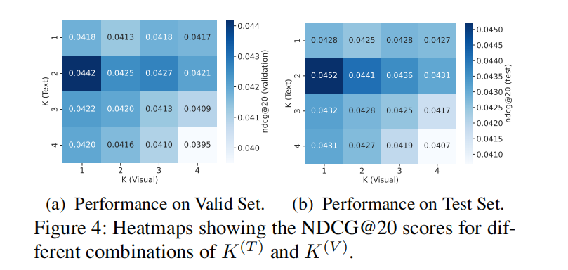
ATAI
Advanced Technique of Artificial Intelligence
ATAI
ChongqingUniversity _{AdvancedTechniqueof}
of Technology Artificial Intelligence
Chongqing University of
Technology
Chongqing University ^{ATAI}
_{of Technology} Advanced Techniqueof
Artificial Intelligence
Chongqing University of Technology
Chongqing University of Technology
Experiments

Slide 10
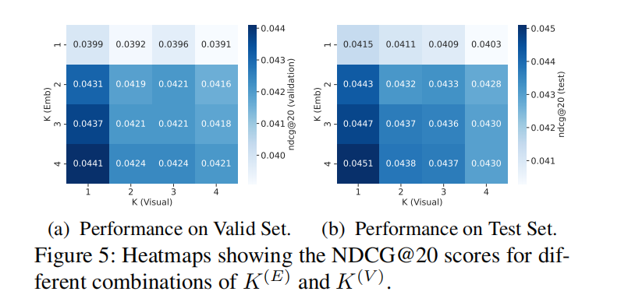
ATAI
Advanced Technique of Artificial Intelligence
ATAI
ChongqingUniversity _{AdvancedTechniqueof}
of Technology Artificial Intelligence
Chongqing University of
Technology
Chongqing University ^{ATAI}
_{of Technology} Advanced Techniqueof
Artificial Intelligence
Chongqing University of Technology
Chongqing University of Technology
Experiments

Slide 11
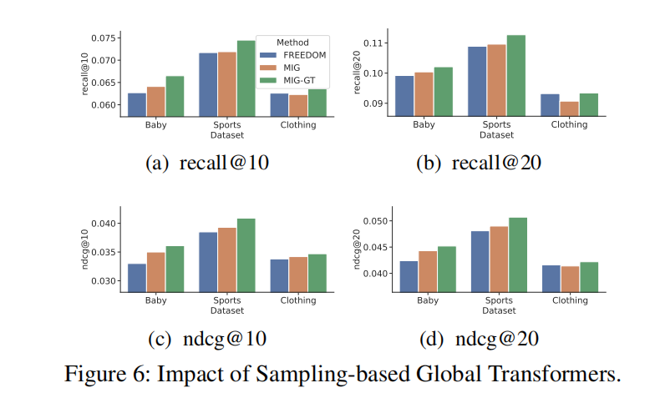
ATAI
Advanced Technique of Artificial Intelligence
ATAI
ChongqingUniversity _{AdvancedTechniqueof}
of Technology Artificial Intelligence
Chongqing University of
Technology
Chongqing University ^{ATAI}
_{of Technology} Advanced Techniqueof
Artificial Intelligence
Chongqing University of Technology
Chongqing University of Technology
Experiments

Slide 12
ATAI
Advanced Technique of Artificial Intelligence
ATAI
ChongqingUniversity _{AdvancedTechniqueof}
of Technology Artificial Intelligence
Chongqing University of
Technology
Chongqing University ^{ATAI}
_{of Technology} Advanced Techniqueof
Artificial Intelligence
Chongqing University of Technology
Chongqing University of Technology
Experiments

Slide 13
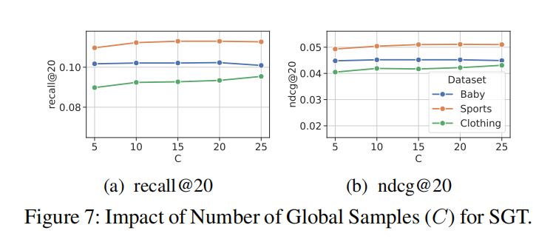
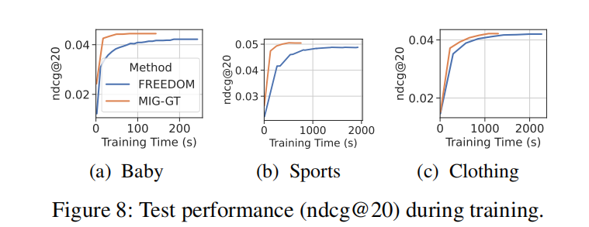
ATAI
Advanced Technique of Artificial Intelligence
ATAI
ChongqingUniversity _{AdvancedTechniqueof}
of Technology Artificial Intelligence
Chongqing University of
Technology
Chongqing University ^{ATAI}
_{of Technology} Advanced Techniqueof
Artificial Intelligence
Chongqing University of Technology
Chongqing University of Technology
Experiments

Slide 14
ATAI
Advanced Technique of Artificial Intelligence
ATAI
ChongqingUniversity _{AdvancedTechniqueof}
of Technology Artificial Intelligence
Chongqing University of
Technology
Chongqing University ^{ATAI}
_{of Technology} Advanced Techniqueof
Artificial Intelligence
Chongqing University of Technology
Chongqing University of Technology
Experiments

Slide 15
ATAI
Advanced Technique of Artificial Intelligence
ATAI
ChongqingUniversity _{AdvancedTechniqueof}
of Technology Artificial Intelligence
Chongqing University of
Technology
Chongqing University ^{ATAI}
_{of Technology} Advanced Techniqueof
Artificial Intelligence
Chongqing University of Technology
Chongqing University of Technology
Thanks!

